Slide 1
CoE Database
Sprint 2
Jacob Santos, Marcus Kelley, Andy Fancher, Brodye Stevens, Ethan Busby
Source Code Website
Project Website
Notes:
Jacob

Slide 2

Project Overview
Database for Connecting Alumni
  Finding Jobs
  Recruiting
  Socializing
Responsive Website
  Relational Database
    Filter System
  Login Security
Notes:
Jacob

Slide 3
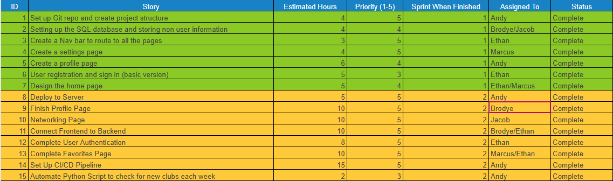
Sprint Backlog
Sprint 1:
Simply setting up the project
Create all pages/components and planning out how to make everything functional
Sprint 2:
Deployment
Adding all the functionality for each page/component
Testing in production environment
Notes:
Marcus

Slide 4

Sprint Reflection
What Went Well
Deploying the project to run on the server
Automating scripts for database updates
Connected the frontend and backend
Meeting all Sprint 2 goals and making solid progress in all aspects of the project
What Didn’t Go Well/Challenges
Version control issues, specifically after deployment and merging changes over different operating systems
Scope changes and determining the future of the project.
Sponsor Feedback
I’ve been extremely impressed with the students working on my project. They’ve shown exceptional professionalism, clear communication and have delivered exactly the kind of product I was hoping for.
Notes:
Andy

Slide 5

Cybersecurity Tasks/Issues
Our consultants noticed there was a high risk vulnerability of Cross Site Scripting (XSS) and made recommendations to fix
Our consultants utilized Snyk to review our source code to check for any other known security issues, each of which was reviewed and the group decided if the issues that were brought up should be fixed
  Most of the issues that Snyk flagged were for outdated libraries
Notes:
Brodye

Slide 6
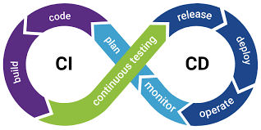

Individual Contributions Part 1
Andy
  Deployed the project to a UA-VPN server set up by UA OIT
  Set up a CI/CD pipeline so updates automatically push to the live site and meet build requirements before deploying
  Automated previously created Python scripts to check UA source for new campus clubs and add them directly to the database
  Worked on the project website
Ethan
  Set up the sign in/out functionality as well as user authorization
  On the networking and favorites pages, connected the frontend to backend to pull the correct user data when you click on another user's profile
  Implemented functionality to favorite a user

Slide 7
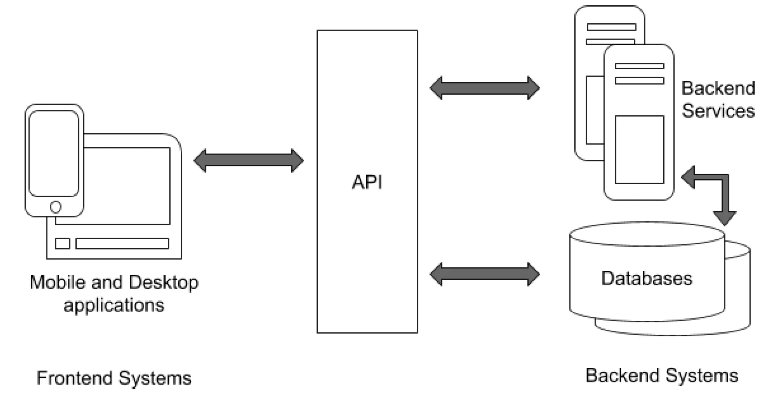
Individual Contributions Part 2
Jacob
  Developed both front and back end of networking page search functionality
  Ensured APIs safely handled user input
Brodye
  Set up User Authentication using JSON Web Tokens (JWTs)
  Applied authentication to all APIs that were to be used exclusively by users
  Implemented Profile creation and updates
Marcus
  Updated the Favorites page and Profile Page User interface
  Modified the Settings Page into a Navbar dropdown

Slide 8
Project Demonstration
Demo
  Be logged onto the UA VPN
  Register a new user
  Create a profile
  Search for other users
  Favorite another user
CoE Alumni Database
Notes:
Ethan

